Slide 1
Introduction to VPNs
What they are
Why you need them
How to use them

Slide 2
What is a VPN and why use one?
VPN stands for Virtual Private Network.
A VPN makes your internet traffic appear from the outside as if you were using the internet from a location not your own.
Most trusted VPN providers encrypt your traffic AND do not track your usage.
The above 2 points allow us to browse the internet without fear of being watched and tracked.

Slide 3
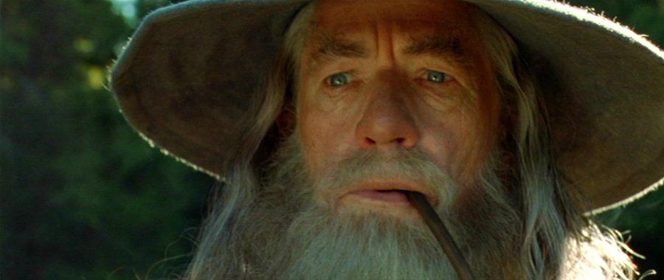
Gandalf is sending a secure packet to Mt Doom

Slide 4
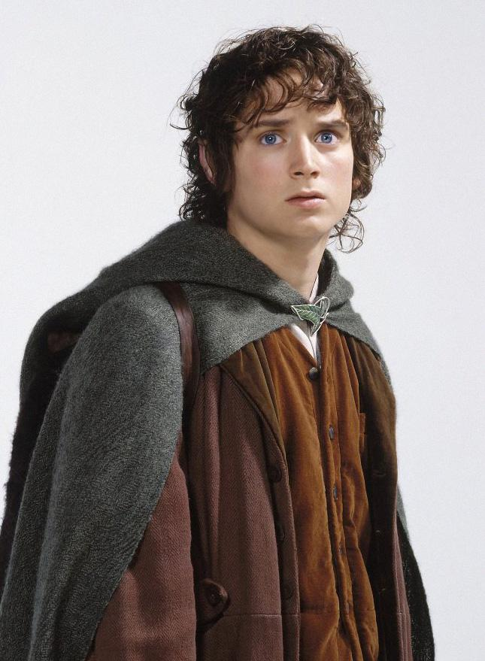
He gives the packet to a trusted Hobbit.

Slide 5
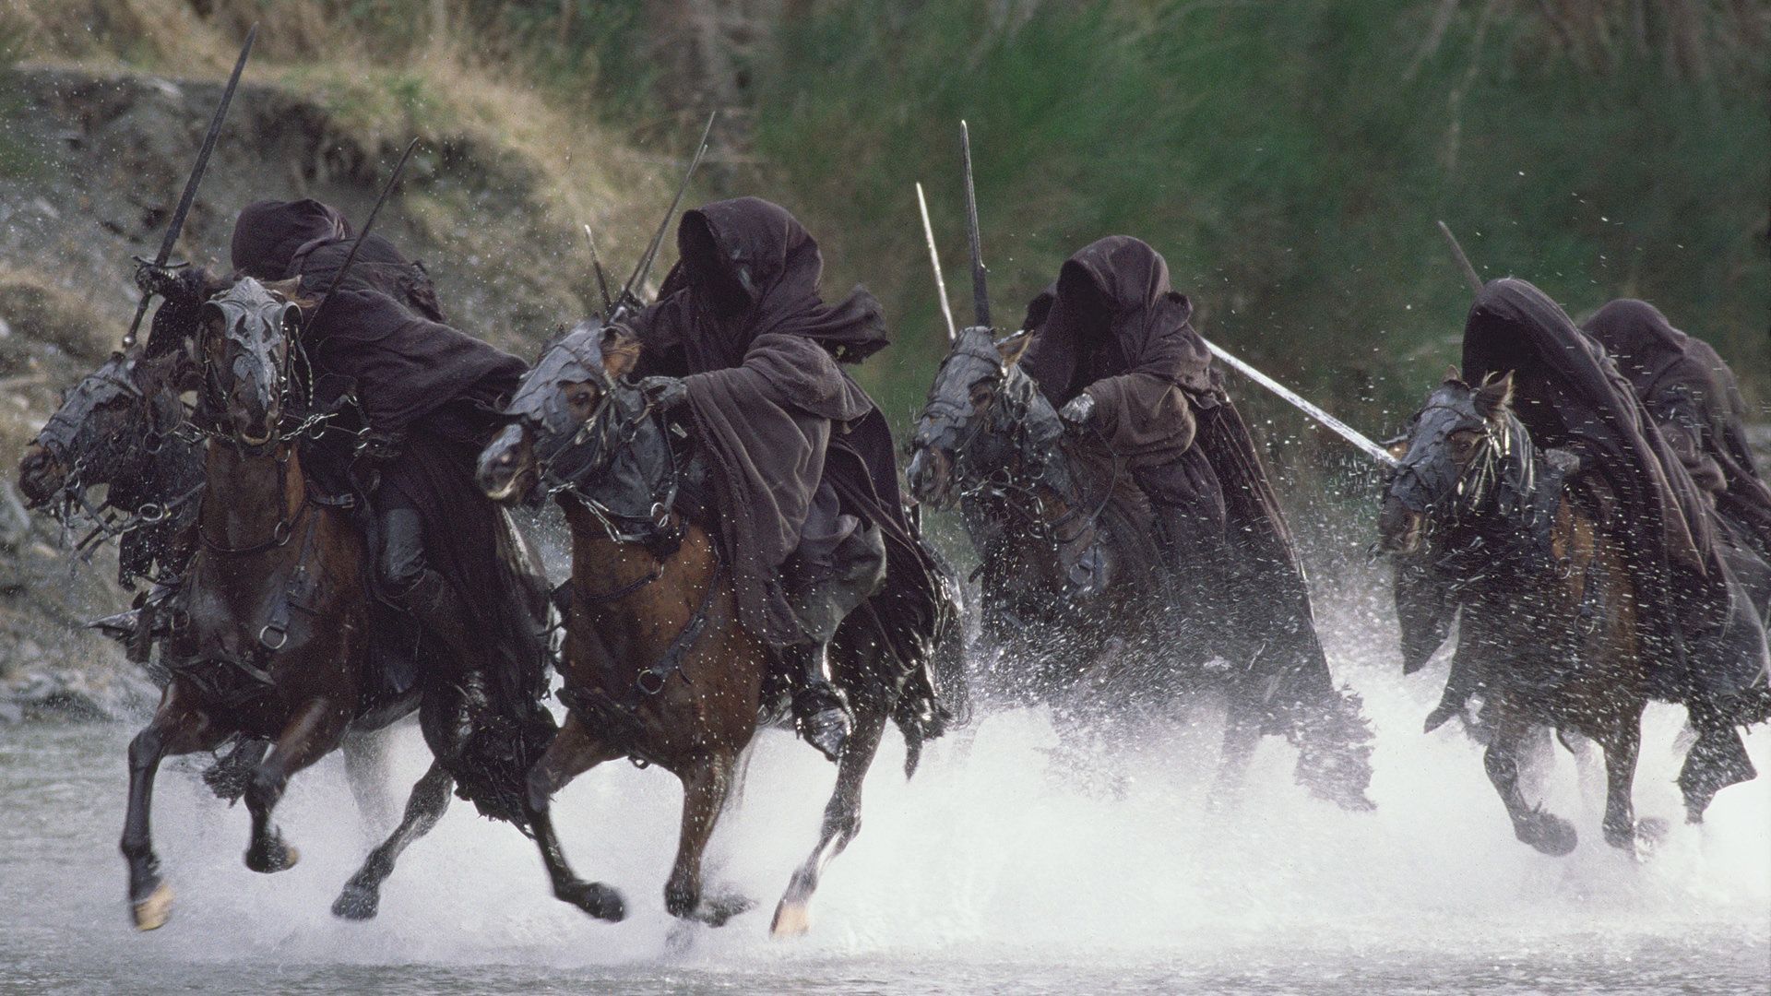
Gandalf hopes that the packet won’t be intercepted

Slide 6
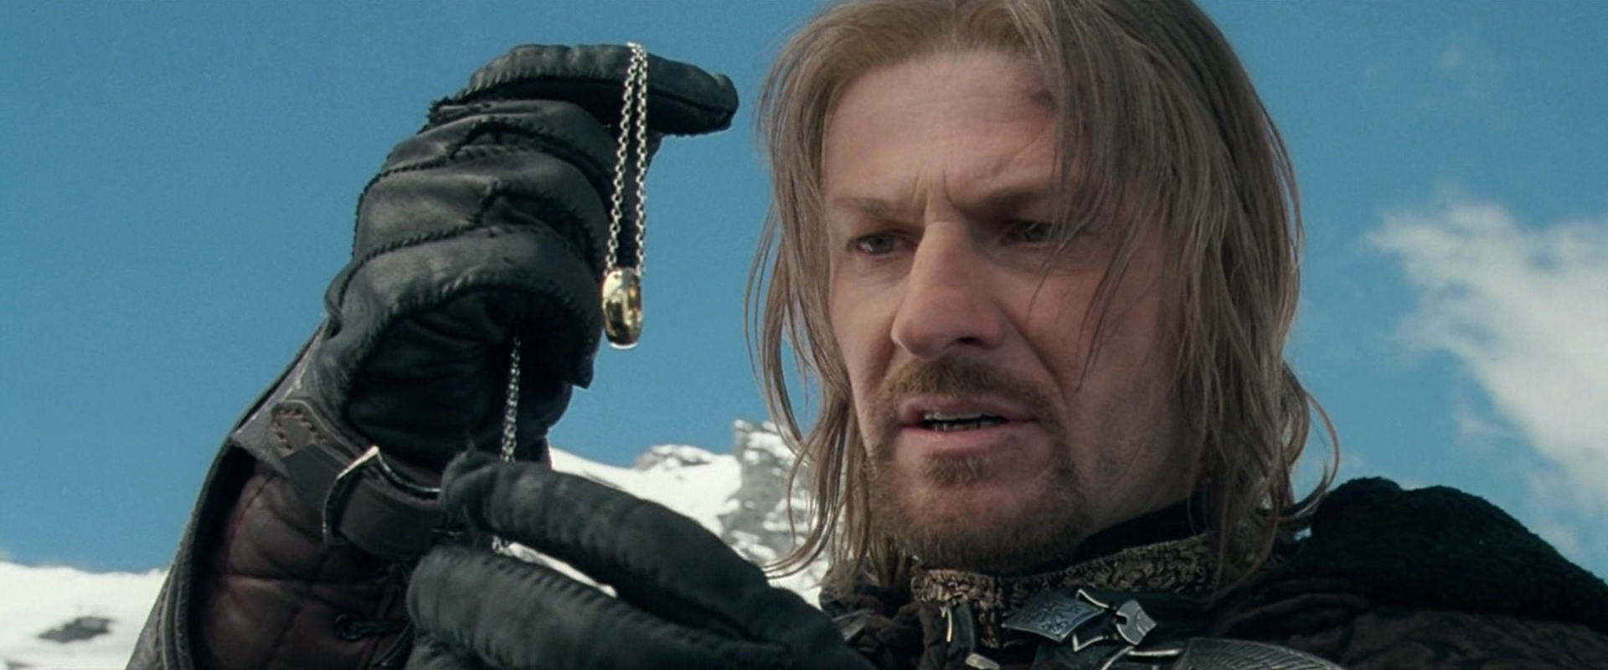
Gandalf trusts every node in his network

Slide 7
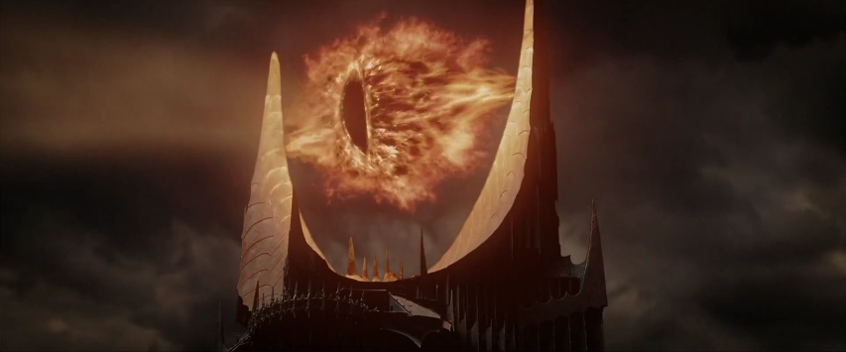
The packet must pass an eye that always watches

Slide 8
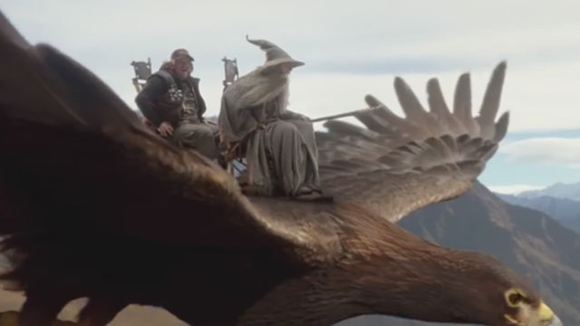
Gandalf should try a VPN

Slide 9
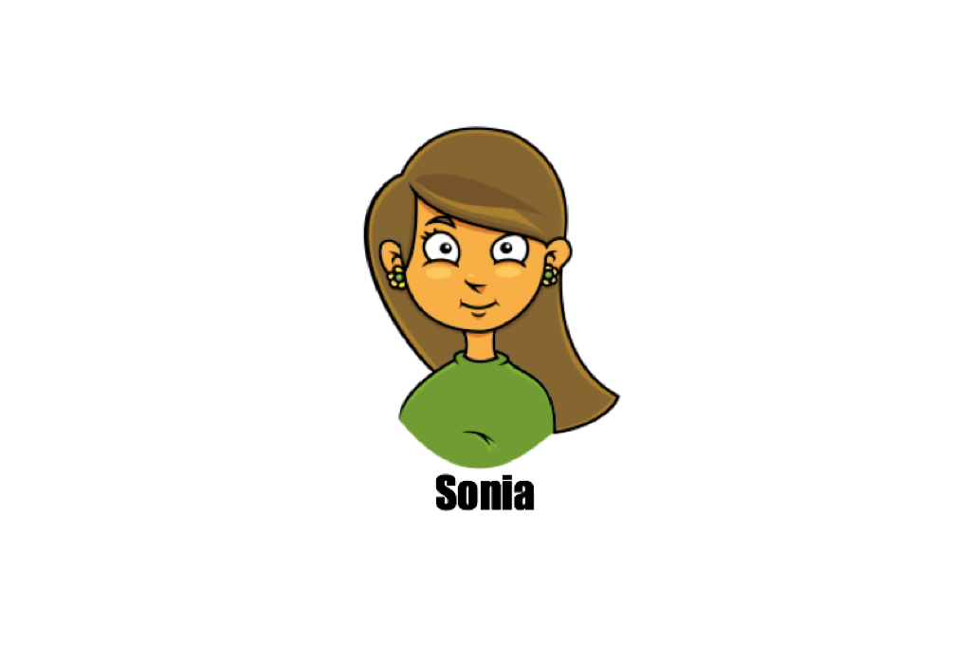
Meet...
Connecting to public wifi at a coffee shop

Slide 10
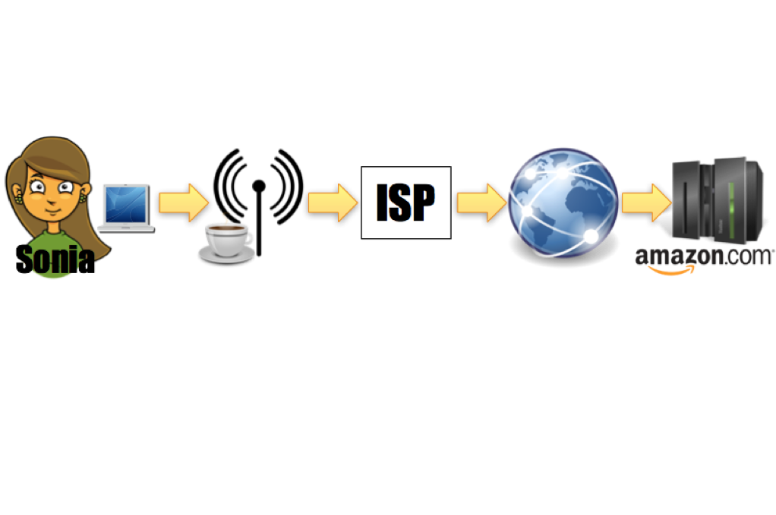

Slide 11
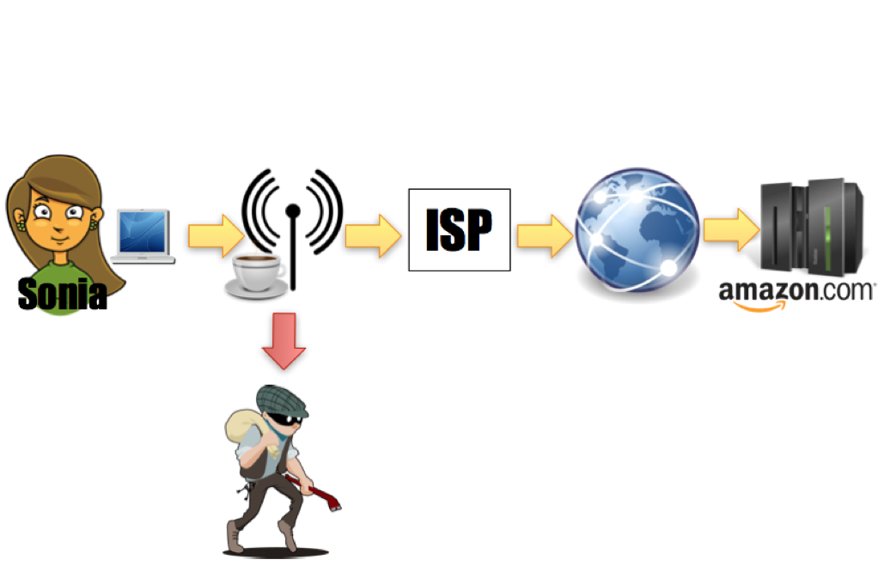

Slide 12



Slide 13
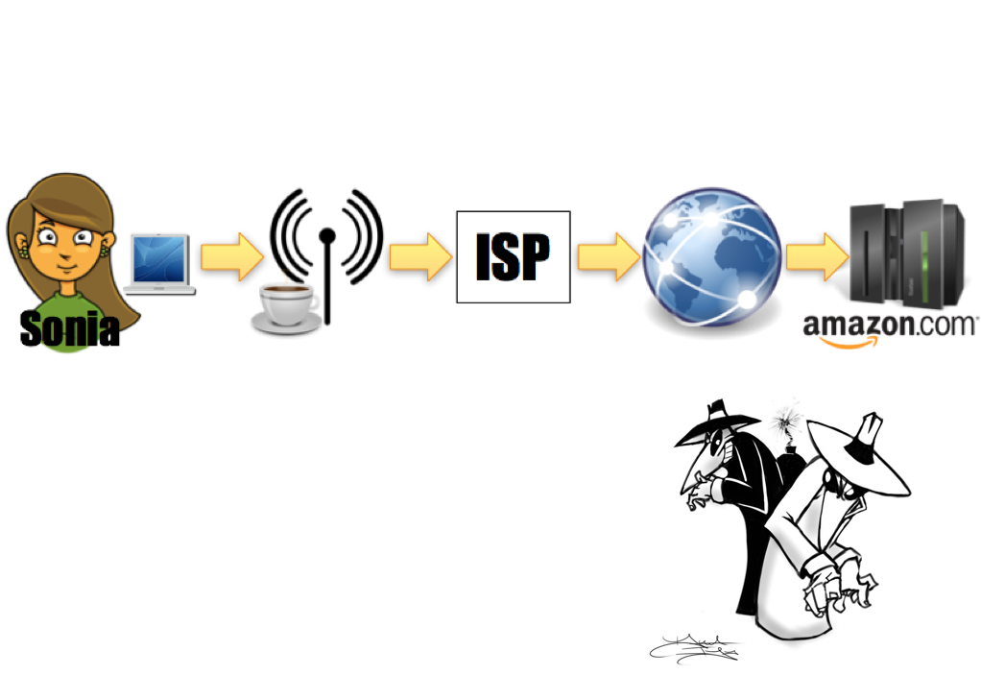

Slide 14
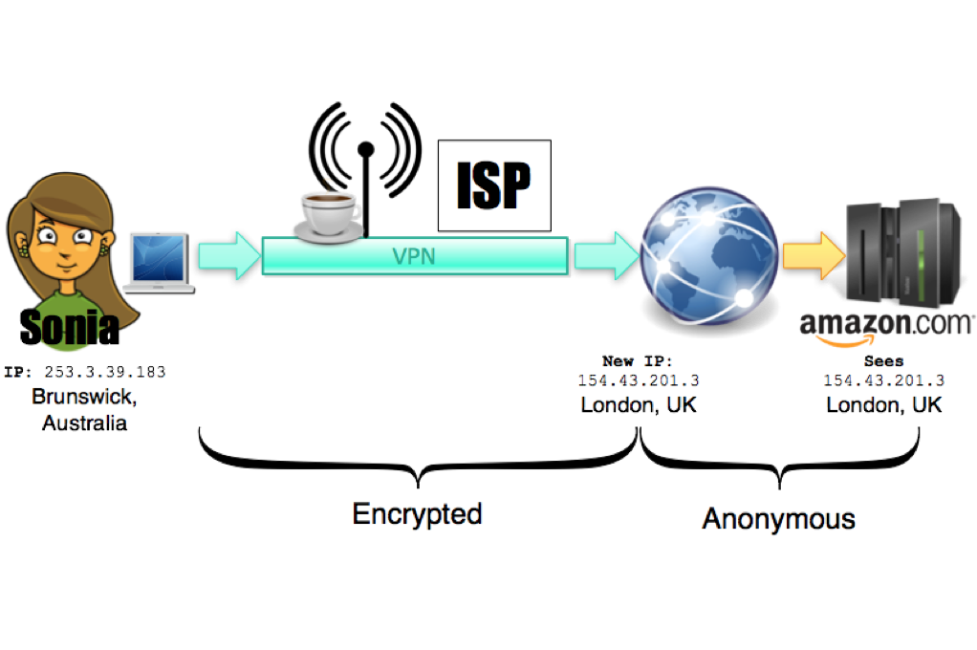

Slide 15
Benefits
Protection from hackers on unsecured wifi networks.
Bypass ISP metadata retention
Access to a website that the country you’re in is blocking
Prevent websites from knowing your real IP address

Slide 16
Demo
https://www.whatismyip.com/my-ip-information/?iref=home

Slide 17

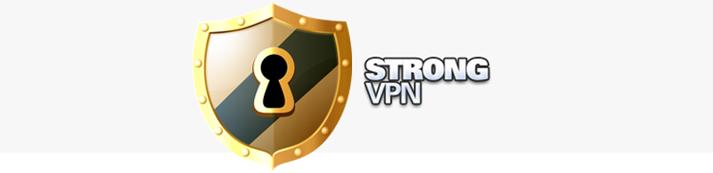


VPN Providers
And more...

Slide 18
Let’s install!
TunnelBear (because it has a free trial, and bears are cute)

